Slide 1
Using Random Forest and Logistic Regression to Predict MSSP Savings/Losses
Daisy Shi

Slide 2
What I will be taking about
1. Introduction
2. Methods and Data Diagnostics
3. Main Results
4. Conclusion

Slide 3
MSSP Overview and Background

Slide 4

WHAT IS THE MEDICARE SHARED SAVINGS PROGRAM (MSSP)?
Provide high-quality, coordinated care to improve outcomes and reduce costs. That’s the primary goal of the Medicare Shared Savings Program (MSSP). The MSSP is an alternative payment model in which eligible providers, hospitals, and suppliers are rewarded for achieving better health for individuals, improving population health, and lowering growth in healthcare expenditures.
FINANCIAL RISK
QUALITY
IMPORTANT CONSIDERATIONS

Slide 5

FINANCIAL RISK
Lowering costs (i.e., ensuring that actual expenditures don’t exceed updated historical benchmark data).
The MSSP provides participants with the following four ACO options, each of which requires an ACO to assume a different level of risk:
Track 1
Track 1 +
Track 2
Track 3

Slide 6
QUALITY
To be eligible for any shared savings that are generated, ACOs must also meet the established quality performance standards for 31 quality measures (29 individual measures and one composite that includes two individual component measures). These MSSP quality measures span the following four quality domains:
Patient/caregiver experience
Care coordination/patient safety
Preventive health
At-risk population
Meeting these MSSP quality standards requires an ongoing commitment to patient-centered care with a focus on proactive health maintenance.

Slide 7
IMPORTANT CONSIDERATIONS
Medicare risk adjustment information, including:
Evaluation of the CMS-HCC Risk Adjustment Model
Model diagnosis codes
Risk Adjustment model software (HCC, RxHCC, ESRD)
Information on customer support for risk adjustment
Joining or forming an ACO may require significant costs

Slide 8
Methods and Data Diagnostics

Slide 9
Study Design
Data:
Performance Year Financial and Quality Results PUF Data
https://www.cms.gov/
Define Outcome
Benchmark Minus Assigned Beneficiary
Binary variable SAVING/LOSS, If positive, total savings. If negative, total losses.
Methods:
Exploratory Data Analysis(EDA)
Classification In Machine Learning(Random Forest)
Logistic Regression

Slide 10
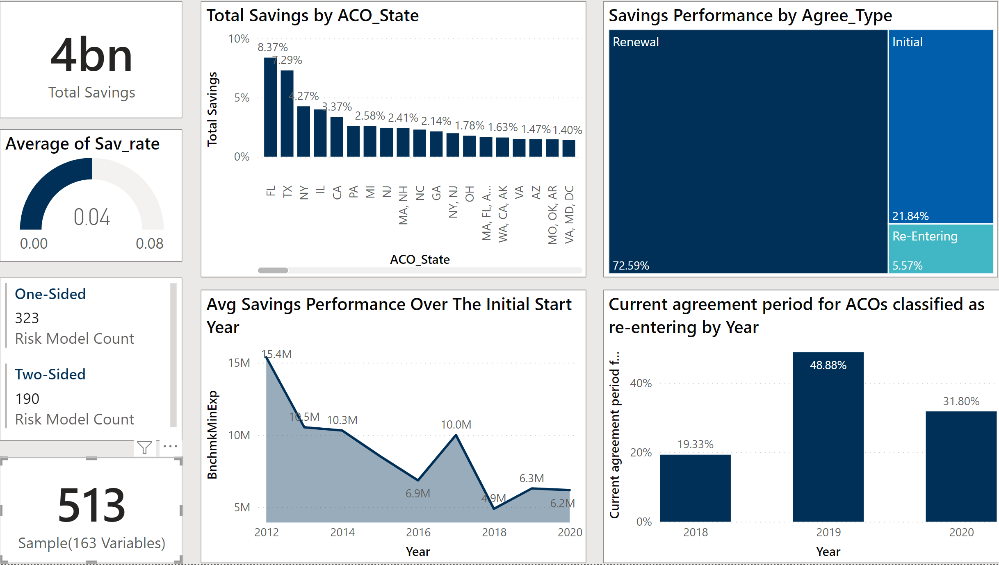
Exploratory Data Analysis(EDA)
The raw data contains 513 rows and 163 columns(features).
The “Saving/Loss” column is the target.

Slide 11
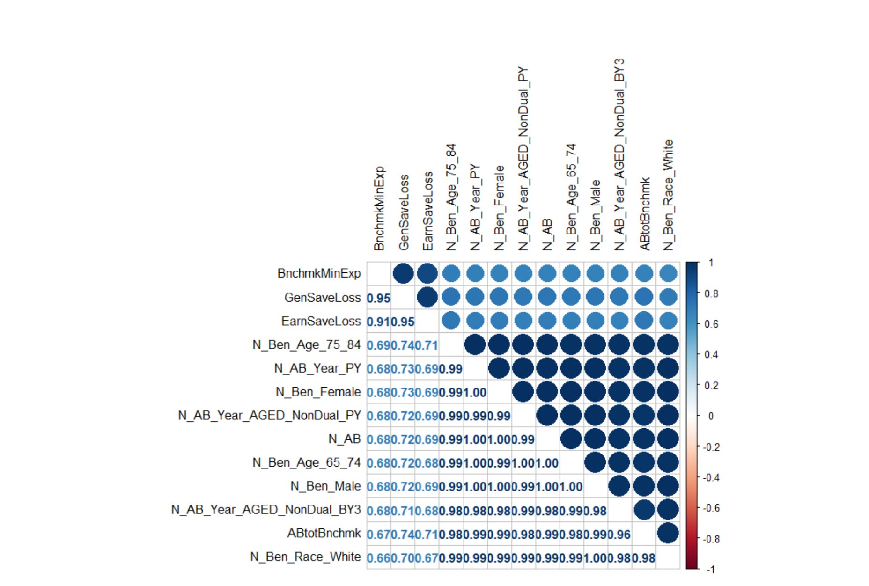
High Correlations
High Correlations With Outcome > 0.65

Slide 12
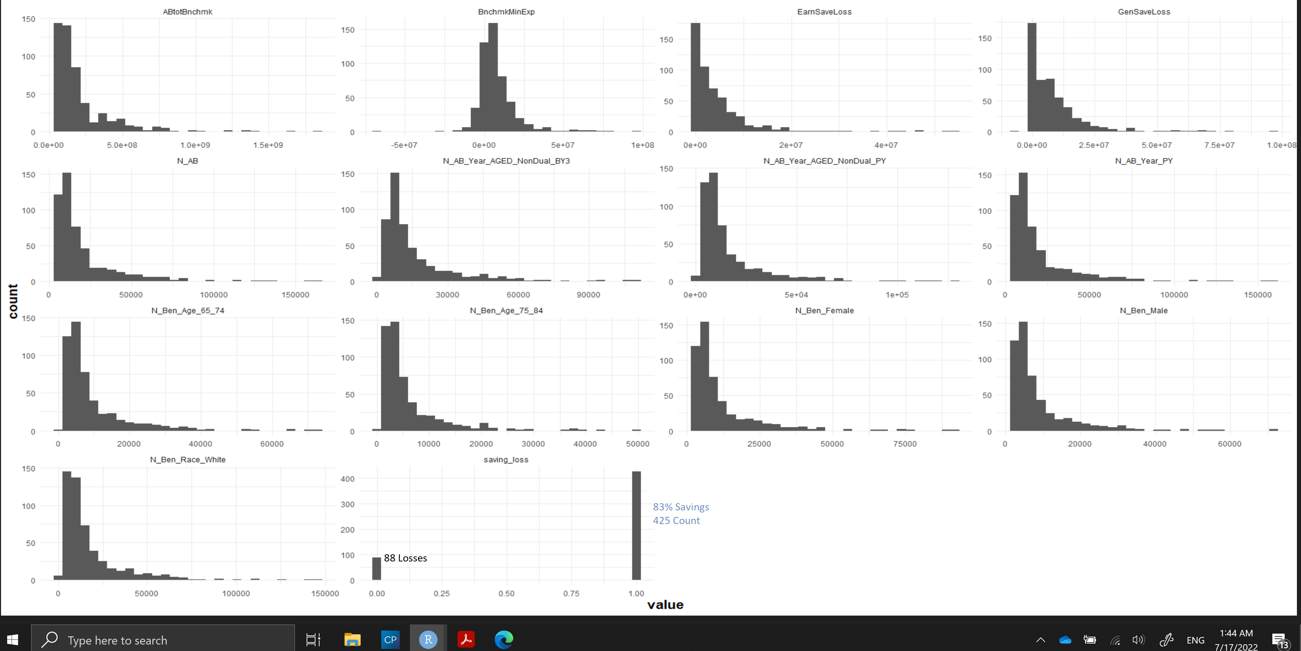
Distributions

Slide 13
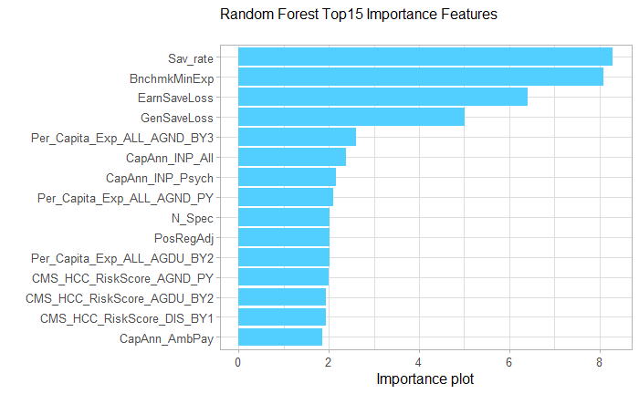
Feature Selection

Slide 14
Logistic Regression Model Output
Deviance Residuals:
Min 1Q Median 3Q Max
-2.6225 0.2277 0.3696 0.5283 1.8133
Coefficients:
Estimate Std. Error z value Pr(>|z|)
(Intercept) 1.8661 0.2207 8.457 < 2e-16 ***
PosRegAdj 0.6483 0.1813 3.576 0.000349 ***
Per_Capita_Exp_ALL_DIS_PY -0.9173 0.2596 -3.534 0.000409 ***
CMS_HCC_RiskScore_AGND_PY 0.8867 0.3182 2.787 0.005323 **
P_SNF_ADM -1.2103 0.4837 -2.502 0.012346 *
---
Signif. codes: 0 ‘***’ 0.001 ‘**’ 0.01 ‘*’ 0.05 ‘.’ 0.1 ‘ ’ 1
(Dispersion parameter for binomial family taken to be 1)
Null deviance: 247.08 on 255 degrees of freedom
Residual deviance: 184.96 on 251 degrees of freedom
AIC: 194.96
Number of Fisher Scoring iterations: 6

Slide 15
Prediction
Confusion Matrix and Statistics
Prediction Loss Saving
Loss 9 7
Saving 31 210
Accuracy : 0.8521
95% CI : (0.8027, 0.8932)

Slide 16
Key Findings
Savings/Losses
Savings performance decreased over the years.
Loss Rate is indeed high. 17% between 2012 and 2020
Predictive Model able to predict outcome of Saving/Loss, the main driver are:
Positive Regional Adjustment(OR = 1.91 )
Per capita DISABLED expenditures(OR = 0.4 )
Average AGED/NON-DUAL HCC risk score in performance year(OR= 2.42 )
Skilled nursing facility discharges (OR= 0.3 )
Risks and Future Analyses Suggestion
Identify high costs items from the specific Chronic Conditions Data
Older group and Disabled group
Re-admissions
Medical utilization
Adjustment process

Slide 17
Thank you!
Questions?

